Slide 1
Basic Electrical and Electronics (ESC-102)
Unit 5
Special purpose Diodes
Course Objectives:
To provide knowledge of special purpose Diodes.
Course Outcomes:
Study the construction, operation and applications of some special purpose diodes.
Contents-
-Characteristics and operation of Zener diode and application as a voltage regulator.
-Basic and structure of LED.
-Application of LED in indicative and lighting displays.
( Numericals are not expected)

Slide 2
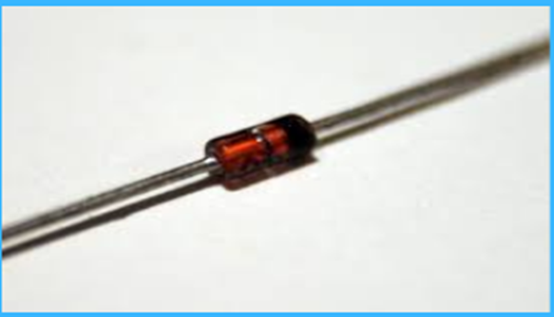
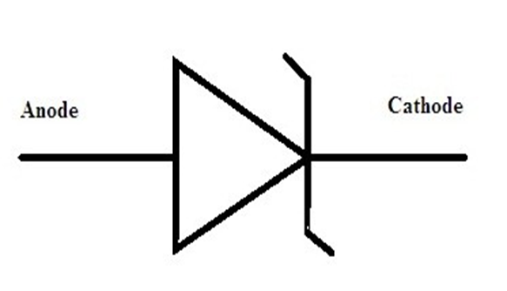
Zener diode
Zener diode is similar to the ordinary PN junction diode. But, it is operated in the reverse biased condition.
This diode is a specially designed highly doped PN junction diode. Therefore, we may say that a heavily doped semiconductor diode, designed to operate in the reverse direction is referred to as the Zener diode.
Also, we may say that the diode which is specially designed for optimizing the breakdown region is the Zener diode.
The depletion region of the diode is very thin due to having heavily doped semiconductor material.
DEFINITION :A properly doped PN Junction diode which has a sharp reverse breakdown is known as Zener Diode. It is also called as VOLTAGE REFERENCE, VOLTAGE REGULATOR OR BREAKDOWN DIODE.
The construction of a Zener Diode is similar to a Silicon PN Junction Diode with a high level of doping concentration.
SYMBOL : PHYSICAL APPEARANCE :

Slide 3
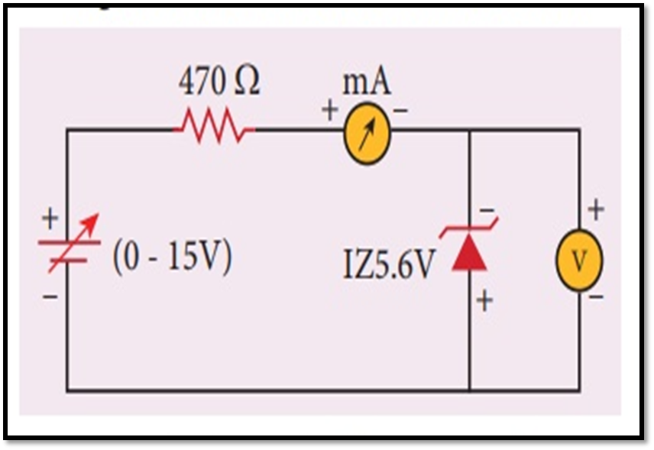
Characteristics of Zener diode
REVERSE BIAS :
When a Zener diode is Reverse biased as shown,
it conducts the reverse current due to minority
charge carriers & this reverse current will be
very small so long as the reverse voltage is less
than Breakdown voltage.
As the reverse voltage is increased to Breakdown
voltage, a large number of electron – hole pairs
are produced and the reverse current sharply
increases.
This reverse current is known as Zener Current and the breakdown voltage is known as Zener Voltage.
If the voltage is again increased beyond the Zener Voltage, then the Zener Current increases but the voltage across the Zener diode remains constant.
Thus it provides a constant voltage and can be used as a Constant Voltage Source.

Slide 4
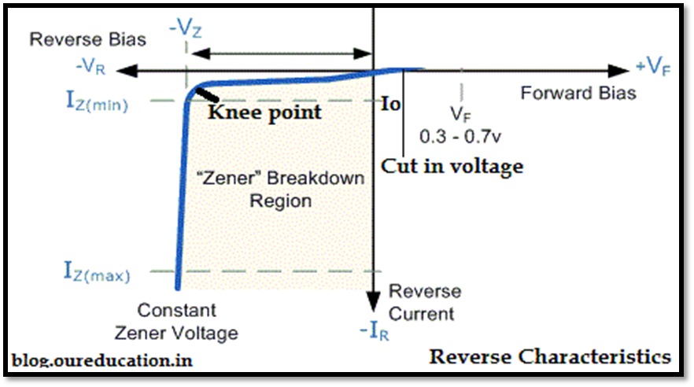
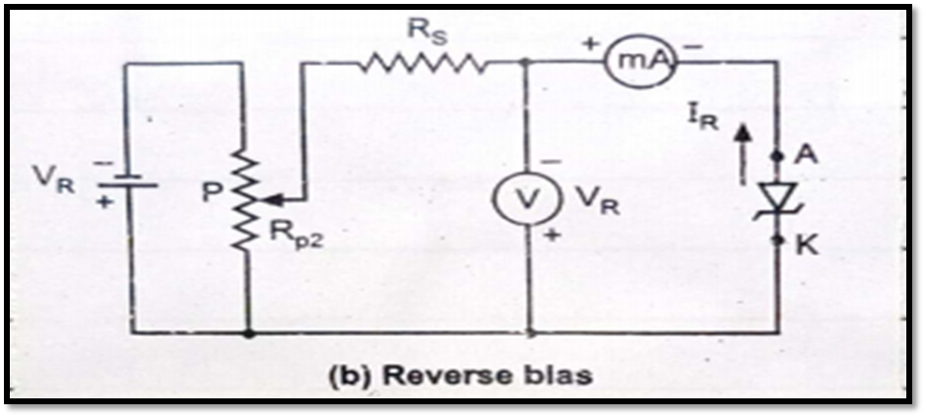
V-I Characteristics
The Reverse characteristic curve indicates that negligible reverse saturation current flows until we reach the breakdown voltage Vz.
The breakdown has a very sharp knee followed by a almost vertical increase in reverse current.
Note that the voltage across the Zener diode is approximately constant and equal to Zener voltage Vz over most of the Zener diode region.
It will come out of the breakdown region when the applied reverse voltage is reduced below the zener breakdown voltage.

Slide 5
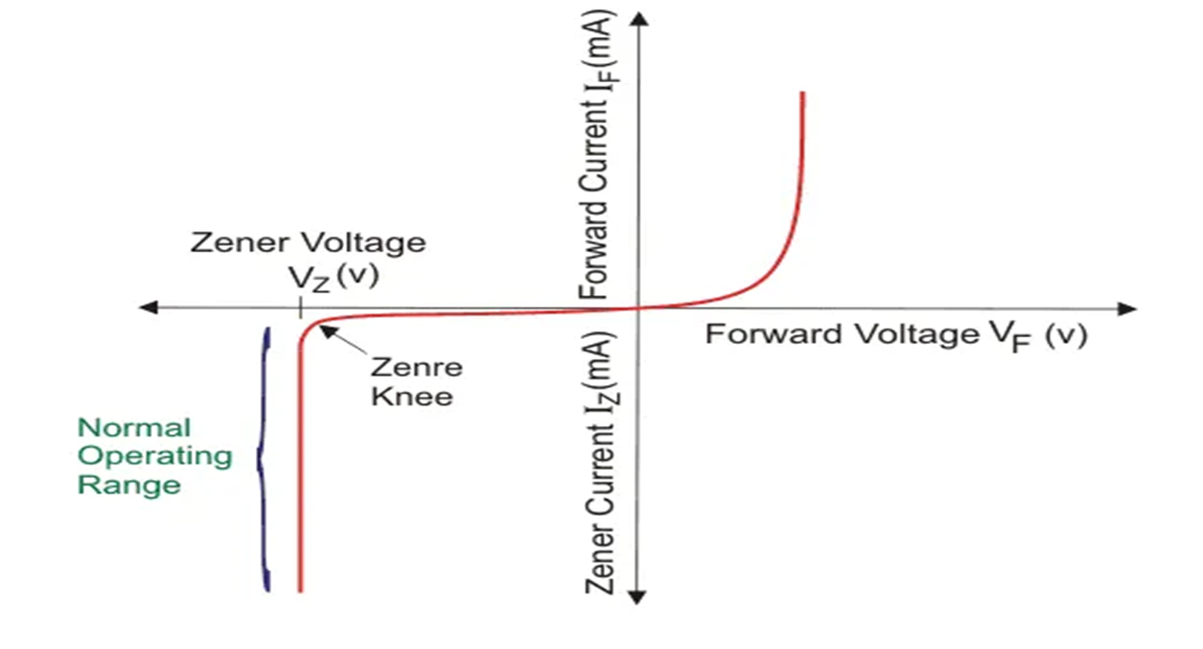
Forward and reverse bias characterstics

Slide 6
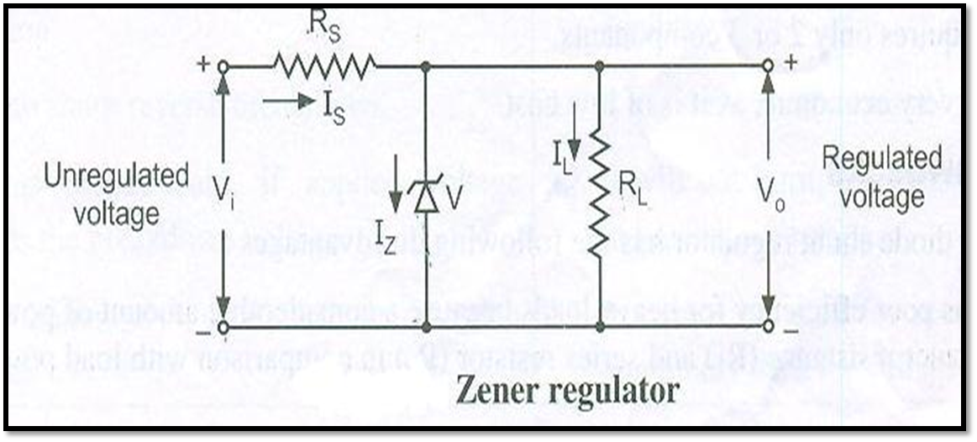
Zener diode as voltage regulator
We know that when Zener diode is operated in breakdown region, voltage across it remains almost constant even if current through it changes by large amount. This property of Zener diode is being used in Voltage regulation.
To get regulated output voltage Vo, Zener diode of breakdown voltage Vz = Vo is connected in parallel with load R_{L} . This combination is connected to output of rectifier (which is unregulated) through the series resistor R_{S} as shown.

Slide 7
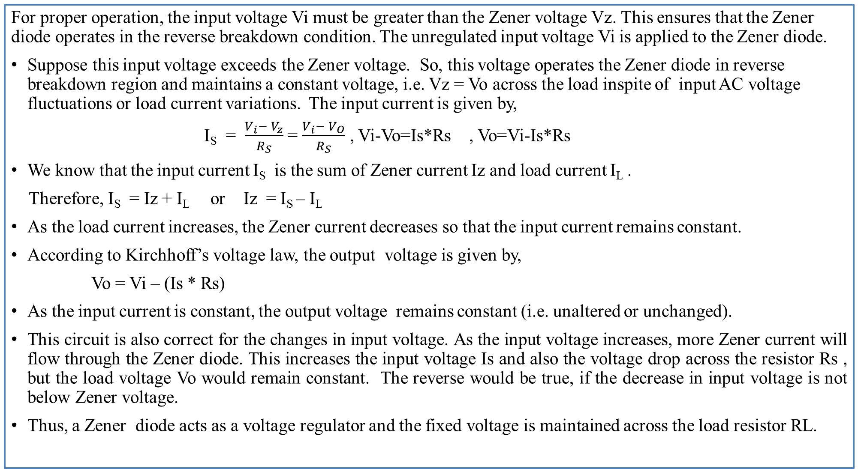
OPERATING PRINCIPLE :

Slide 8
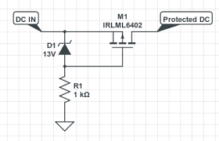
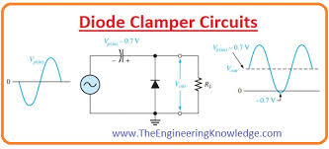
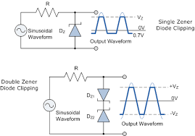
Zener diode
Applications
DC Voltage regulator
Over voltage Protection circuits for
MOSFETs.
3. Clamping Circuits
4. Clipping circuits
Material used for fabrication-Silicon ,Germanium

Slide 9
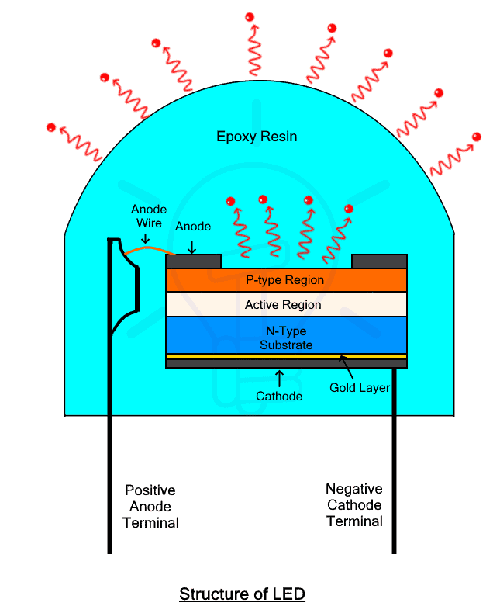
Basic and structure of LED
The basic structure of an LED consists of a semiconductor chip, typically made from compound semiconductors, that emits light when an electric current passes through it.
Key Components of an LED
Semiconductor Material: LEDs are made from compound semiconductors
such as Gallium Arsenide (GaAs), Gallium Phosphide (GaP), or
Indium Gallium Nitride (InGaN). These materials are chosen based on
the desired wavelength (color) of the emitted light.
P-N Junction: The core of an LED is the P-N junction, which is
formed by combining P-type (positively charged) and N-type
(negatively charged) semiconductors. When voltage is applied,
electrons from the N-type region recombine with holes in the
P-type region, releasing energy in the form of photons (light).

Slide 10
The structure of a Light Emitting Diode (LED) consists of three main layers:
1. P-type semiconductor layer: This layer has a majority of holes (positive charge carriers).
2. N-type semiconductor layer: This layer contains a majority of electrons (negative charge carriers).
3. Active region: This is the junction between the p-type and n-type layers where recombination of electrons and
holes occurs, leading to light emission.
These layers work together to allow the LED to emit light when an electric current passes through it.
4. Anode: P-type layer connected to the positive terminal of the battery.
5. Cathode: N-type layer connected to the negative terminal of the battery.
6. Encapsulation: Transparent epoxy dome to enhance light extraction.
Working Process: When forward-biased, electrons from the n-region and holes from the p-region are pushed toward the junction. They start recombining in the active region, emitting photons in the process.LED does not emit light when it is reverse-biased. The wavelength (colour) of the emitted light depends on the semiconductor material's bandgap energy. Different materials like GaN, GaAsP, GaP, etc. are used to make LEDs of different colours.
The emission colour of an LED depends on the semiconductor material used and its bandgap energy. Different materials, like GaN, GaP, GaAs, etc., and their alloys emit different wavelengths from blue to red by tuning the bandgap. This allows the generating of various coloured LEDs with different forward voltages and optical properties.

Slide 11
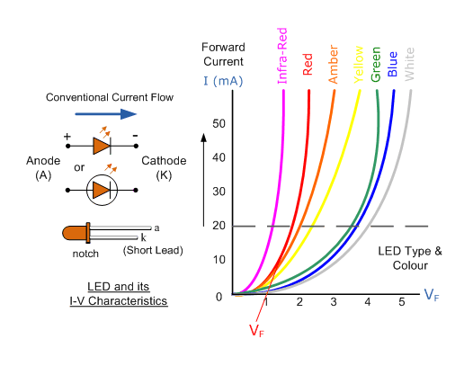
Advantages of LEDs
1.High luminous efficiency: LEDs convert over 80% of electrical energy
into light, compared to 10% for incandescent. This makes them highly
energy efficient.
2. Long lifespan: LEDs can last up to 100,000 hours, reducing the need
for frequent replacements.
3. Durable: LEDs are highly shock and vibration-resistant due to their
solid-state nature.
4. Compact: LEDs are much smaller than bulky incandescent bulbs.
5. Fast switching: LEDs can be turned on/off rapidly, making them ideal
for optical communications.
6. Low voltage operation: LEDs operate at low voltages typically 1.5 to
3.5V, making them safe to use.
7.Cool operation: LEDs emit less heat compared to traditional bulbs
removing the need for cooling.
8.Mercury-free: LEDs are eco-friendly as they do not use toxic materials
like mercury.
9.Design flexibility: LEDs can be made very small and shaped into tiny
packages.
10.Controllable brightness: LED brightness can be varied by changing
the supplied current

Slide 12
Limitations of Light Emitting
1.Uni-directional: LEDs conduct in only one direction
(forward-biased) hence, care must be taken during
connections.
2.Heat sensitivity: Excess heat can reduce LED lifetime
and efficiency. Proper heat sinking is required.
3. Voltage-sensitive: LEDs are prone to damage from
voltage spikes, so surge protection is essential.
4. High initial cost: The upfront cost of LED lighting is
still more than traditional lighting.
5.Efficiency droop: Efficiency decreases at high input
power densities, limiting light output.
6. Light spectrum: The emitted spectrum
is narrow compared to incandescent lights.
7.Light distribution: LEDs produce directional lighting,
and diffusers are needed for ambient lighting.
Applications
Indicators and Signalling: LEDs are used as Status indicators, Numeric and Alphanumeric displays, Traffic signals, and Sign boards, etc.
Lighting Applications:In General Lighting, Street Lighting, Automotive Lighting, and Stage/Studio Lighting.
In Healthcare, LED surgical lamps, medical equipment lights, and sterilisation via ultraviolet wavelengths.
In Aviation, replacing conventional fittings inside aircraft cabins for improved lighting and lower maintenance.
In Optical Communications: Visible and infrared LEDs find major use in short-range optical data transmission applications, such as in:fibre optic cables, Li-Fi technology, remotes for wireless control signalling, and Optical Mice, etc.
Sensing and Detection: LEDs play a critical role in numerous
sensing and measurement applications such as:in barcode and
document scanners, movement tracking (with photodiodes and
cameras), pattern recognition, in analytical devices, Pulse
oximeters and capnographs, Spectrofluorometers, fluorescence
sensors (for detection of bacteria, virus, etc.).
Displays and Video Screens: LED technology has revolutionized the display and interface systems with widespread applications.It is used in Mobile phones/smartwatches, LCDs (as a backlighting source), LED TVs, computer monitors, Digital billboards/signage, etc.
Other Applications: Besides lighting and displays, LEDs have many
other useful applications including:Machine vision, Phototherapy,
Night vision illumination, Currency validation, and Optocouplers.

Slide 13
Application of LED in indicative and lighting displays.
LEDs are used in indicative and lighting displays from simple status lights on electronics to complex, high-definition screens.
For indicative purposes, they serve as power-on lights on devices, dashboard indicators in cars, and traffic and railway signals. For lighting displays, LEDs illuminate a wide range of applications, including general indoor and outdoor lighting, large screens like digital billboards and televisions, and the backlights for smartphones and monitors.
Examples-

Slide 14
1. On electronic devices: Small LEDs are used to show power status, network connectivity, or error conditions on anything from a laptop to a microwave.
2. In vehicles: LEDs are used for a variety of dashboard and exterior indicators, such as turn signals, brake lights, and instrument panel lights.
3. For signals: LEDs are a core component in traffic lights, railway signals, and even emergency exit signs, providing clear, visible, and long-lasting signals.
4.In optical communication: They transmit data via pulses of light, such as in remote controls and fiber optic systems.
For lighting applications-
Examples-
1. General and decorative lighting: Their efficiency and longevity make them ideal for home, office, and street lighting.
2. Large-scale displays: Modern television screens, computer monitors, and digital billboards use LED technology to create vibrant, high-contrast images.
3. Backlighting: LEDs are frequently used as backlights for liquid crystal displays (LCDs) in smartphones, tablets, and televisions.
4. Automotive lighting: Beyond indicators, LEDs are used for headlights, taillights, and interior cabin lighting, offering brighter, more energy-efficient illumination.

Slide 15
Practice Questions
Explain Zener diode as voltage regulator. Give reason “Zener diode is called as special purpose diode”.
Compare avalanche and Zener breakdown ( any 4 points)
Draw and explain working principle of LED with neat diagram and sktech V-I characteristics of. List 4 applications of LED.
Compare Zener diode and LED.4 points
List applications of LED as indicative and display device.
Explain construction of LED with neat sketch.
Explain characteristics of Zener diode with practical set up.
List the materials for LED and its various colors.

